Slide 1
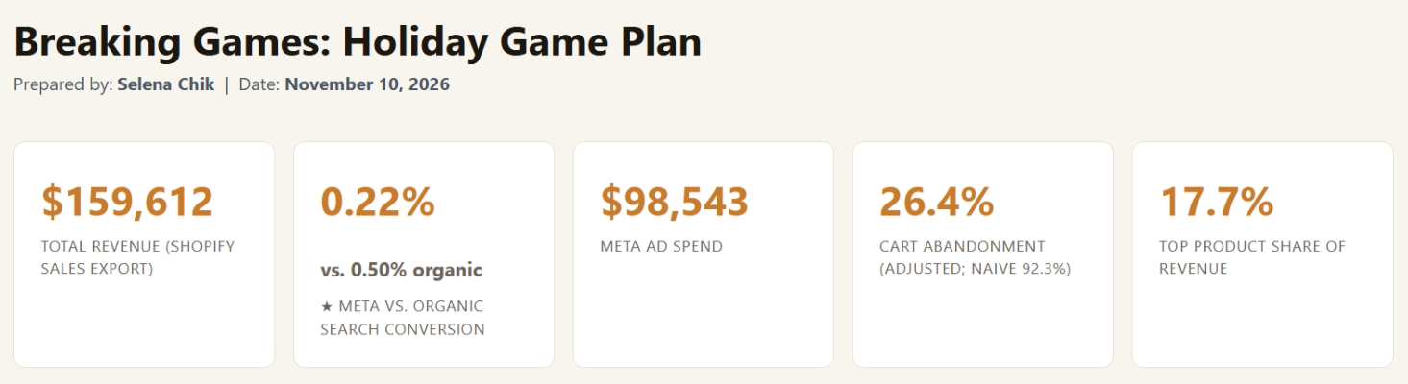
How I built Breaking Games' holiday dashboard
Selena Chik
I turned six raw exports into one connected SQLite database, then built a one-page dashboard on top of it.
Notes:
Hi, I'm Selena. Over the externship I took Breaking Games' six raw exports, connected them into one database, and built a dashboard that answers three Q4 questions: what to reprint, where ad money should go, and whether checkout is actually broken. The next two slides are how I built it; then what it shows; then one idea of my own.

Slide 2
Architecture
HOW I BUILT IT
2 / 6
Every card, table and chart on the dashboard comes from two tables and one view.
RAW DATA FILES
WHAT I BUILT
WHAT FEEDS THE DASHBOARD
DASHBOARD
shopify_sales
dim_product
dashboard_metrics
dashboard.html
+ product_id I added
table · reads: shopify_sales
table · reads: shopify_sales, shopify_orders, meta_campaigns, clean_checkouts, referrals, dim_referrer
numbers copied in by hand
shopify_orders
dim_referrer
table · reads: referrals
shopify_checkouts
dashboard_leaderboard
fact_product_performance
table · reads: shopify_sales
referrals
table · reads: dim_product, shopify_sales, referrals. Used for the reorder rec, not the dashboard
dashboard_channels
meta_campaigns
view · reads: referrals, dim_referrer
meta_ad_sets
clean_checkouts
(not used)
view · reads: shopify_checkouts
Notes:
Read left to right. Six raw exports on the left. In the middle, the four objects I designed: two dimension tables, a summary table for the reorder rec, and the clean_checkouts view that filters bots. On the right, the three objects the dashboard reads. meta_ad_sets isn't used because its spend repeats the campaign totals; adding both would double-count.

Slide 3
Three design decisions
HOW I BUILT IT
3 / 6
Each of these fixes one problem in the raw exports.
PROBLEM
WHAT I DID
HOW I CHECKED
dim_product
One row per product (116) with a generated product_id, also added to shopify_sales. Sales stay in the sales table.
All 116 sales rows got a product_id; 184 of 185 named order rows match. Limit: URL slugs match only 45 of 116 product pages, none in the Dwellings line.
No shared product key across the exports.
dim_referrer
Grouped into 7 channels plus Other, including a Bot / Suspicious bucket. Paid Social (Meta) = facebook, instagram, meta, internalfb.
All 823,393 pageviews map to a channel; Other is only 0.6%. Limit: with no UTM tags, I can't tie one visit to one order.
470 different referrer names.
clean_checkouts
Two rules set before counting: a line with more than 5 copies of one item, or an email with more than 5 carts. A view, so it updates itself.
1,197 carts down to 1,162 (35 removed). Rules I tested and dropped (missing email, zero subtotal) caught 0 carts. Risk: a store buying 6 copies gets dropped.
Bot carts inflate abandonment.
Source: dim_product, dim_referrer, clean_checkouts
Notes:
Each row is a problem in the raw data, what I built to fix it, and how I checked it worked, including what it still misses. The slug limit is the big one: the best-selling Dwellings line has URLs that don't follow its product names, so traffic numbers never decide a reorder bucket.

Slide 4
One metric, three answers
WHAT IT SHOWS
4 / 6
Cart abandonment looked like 92.3%. Measured fairly, it's 26.4%.
92.3%
29.8%
26.4%
First try
All carts ever, against one month of orders.
Same month
Bots removed
Carts and orders from August 2026 only.
6 bot carts from one email taken out.
1 − 92 orders ÷ 1,197 carts
39 carts ÷ (39 carts + 92 orders)
33 carts ÷ (33 carts + 92 orders)
Matching the month mattered far more than the bots: 62.5 points vs 3.4 points.
Source: shopify_checkouts, shopify_orders (clean_checkouts view)
Notes:
The checkout file goes back to 2016, but orders cover only August 2026. Comparing those gave 92.3%. Matching the month alone brings it to 29.8%. Removing the bot carts, here the six carts one email opened in 63 seconds, brings it to 26.4%. The export only holds unfinished carts, so the fair formula is abandoned divided by abandoned plus completed.

Slide 5
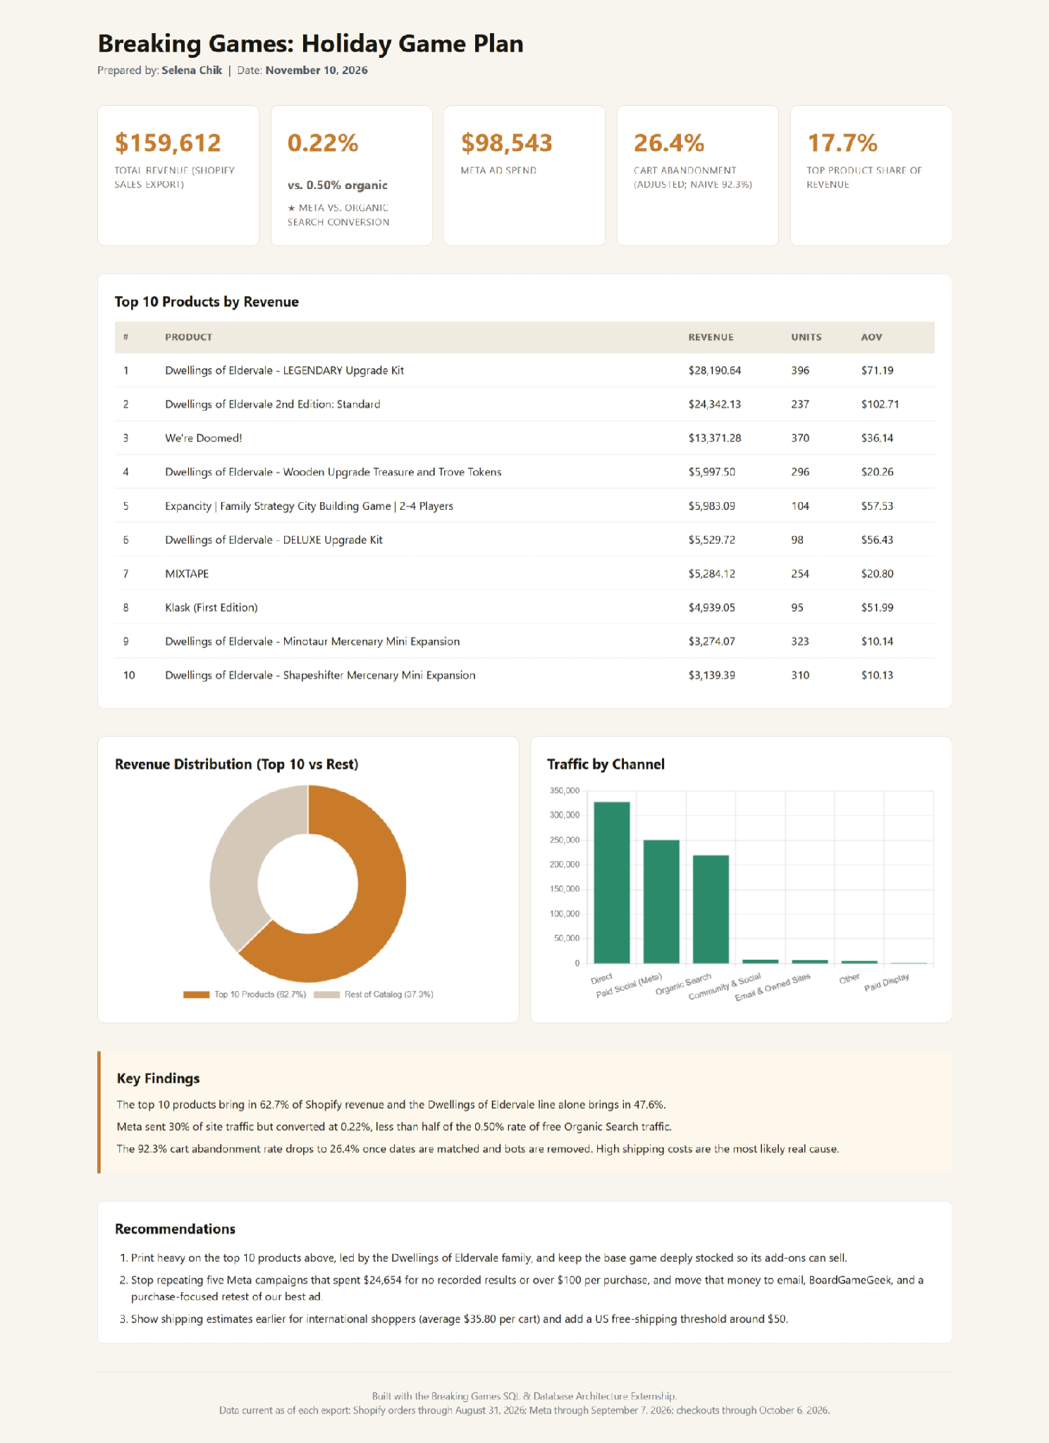
The dashboard
WHAT IT SHOWS
5 / 6
Five numbers, a top-10 leaderboard and two charts. The ★ number is one I added: visitors from Meta, our only paid channel, reach checkout at less than half the rate of free search traffic.
How 0.22% vs 0.50% is built
1
referrals
Pageviews and checkout sessions for each of 470 referrers
dim_referrer
2
facebook, instagram, meta, internalfb → Paid Social: 553 of 250,618. google, bing + 9 more → Organic Search: 1,093 of 219,555
dashboard_metrics
3
meta_conversion_pct = 100 × 553 ÷ 250,618 = 0.22; organic = 100 × 1,093 ÷ 219,555 = 0.50
4
Dashboard card
Live dashboard: [paste Google Drive link]
0.22% vs 0.50%, placed next to the $98,543 Meta spend card
Notes:
The room can read the cards, so I won't. The one to notice is the starred card. Meta is the only channel with spend data, and its visitors reach checkout at 0.22%, against 0.50% for search traffic we don't pay for. I put it right next to Meta spend so the two are read together. Even if Meta's real rate were double what I measured, it would still sit below organic search.

Slide 6
My idea for Breaking Games
WHAT'S NEXT
6 / 6
Show shoppers how close they are to free shipping, with a one-click Dwellings add-on to get them there.
AUGUST 2026 ORDERS BY SIZE, WITH AVERAGE SHIPPING PAID
Why it would help
Under $25
49 · $5.48
Free shipping at $50 already exists: every US cart of $50 or more in 2025 and 2026 shipped free. But 66 of 92 orders (72%) fell short and paid shipping. A $7 to $10 Dwellings add-on, like the Oracle Hex Tile or a mini expansion, closes most of the gap.
$25 to $50
17 · $6.51
$50 and up
26 · free
What it would take
17 of 92
August orders fell between $25 and $50, on average $17.30 short of free shipping.
A free-shipping progress bar in the cart (a Shopify theme setting or app) and a short list of add-ons the store already sells. Then track the share of orders at $50 or more in shopify_orders.
Source: shopify_orders (August 2026), clean_checkouts. One month of orders, so a test, not a proven result.
Notes:
While checking my shipping numbers, I found Breaking Games already ships free at 50 dollars. Every US cart of 50 dollars or more in 2025 and 2026 had zero shipping. But almost three in four August orders came in under that line and paid shipping. The 17 orders between 25 and 50 dollars were about 17 dollars short on average, which is roughly one or two add-ons like the Oracle Hex Tile or a mini expansion. It's one month of data, so I'd run it as a test and watch whether the share of orders over 50 dollars goes up.

